Slide 1
The Battle of Neighborhoods
By. Besher Abdul Razzaq

Slide 2
Introduction and Business Problem
A client is interested in starting a water park in the best locality of all the cities in United States. He defines the below requirements:
1. Population density of a locality
2. Per Capital income
3. Population of each location
4. Venues in each locality
We have to propose the best locality to set up a water park in the United States

Slide 3
Data
To help set up a Water Park, we will get the data from the below sources:
List of all the cities in United States with population density and coordinates: https://en.wikipedia.org/wiki/List_of_United_States_cities_by_population
List of all the cities in United States with Per Capita Income : https://en.wikipedia.org/wiki/List_of_United_States_counties_by_per_capita_income
Using Four Square API to get the following:
1. List of all venues in each city
2. List of all venues in each locality in the selected city

Slide 4
Methodology
In order to do the analysis and suggest the best location, following steps were followed:
The Wikipedia pages (https://en.wikipedia.org/wiki/List_of_United_States_cities_by_population) and (https://en.wikipedia.org/wiki/List_of_United_States_counties_by_per_capita_income) were scraped using the Beautiful Soap library to build a pandas dataframe listing the cities, states, coordinates, area, per capita income and population density. The data was cleaned and processed appropriately.
The Foursquare API is then used to get the venues in each city based on categories as required by the client.
K-means is being used to cluster the venues based on the category and get the coordinates of the cluster that has the maximum weight

Slide 5

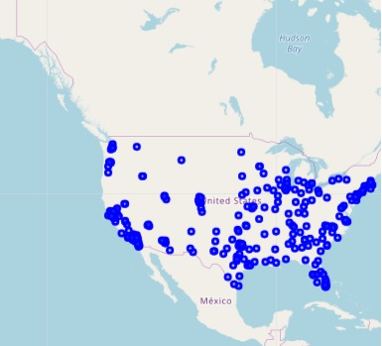
Plot of all cities of USA that were extracted
Blue dots indicate the city center in the country map of the United States.

Slide 6
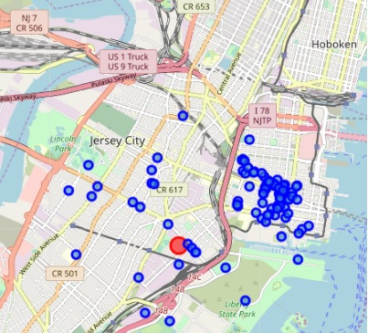
Map of venues in the Jersey City:
Based on the constraints we have chosen, we found that Jersey City would be the better place to start.

Slide 7
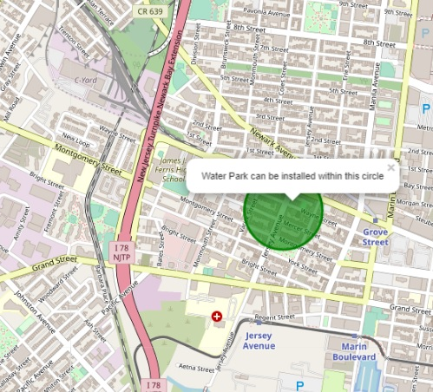
Result
The circle indicates the best place to start a water park in the Jeresy City.

Slide 8
Recommendations / Improvements
In the Foursquare API, we have queried the venues of a locality by specifying the limit and radius of our choice. We have chosen less limit as the number of API calls that can be done using a free account in Foursquare are less.
We can increase the limit for more accurate results.
We can increase the radius for more venue results from each city.
In the venue categories we are choosing only few out of 2000 that are available to give weight and identify the best cluster.

